Slide 1

CSE 470/598 Curves and Surfaces
Ross Maciejewski
rmacieje@asu.edu

Slide 2
Disclaimer
These slides can only be used as study material for the class 470 at ASU
The slides cannot be distributed or used for another purpose

Slide 3
Objectives
Introduce types of curves and surfaces
Explicit
Implicit
Parametric
Strengths and weaknesses
Discuss Modeling and Approximations
Conditions
Stability

Slide 4
Escaping Flatland
Until now we have worked with flat entities such as lines and flat polygons
Fit well with graphics hardware
Mathematically simple
But the world is not composed of flat entities
Need curves and curved surfaces
May only have need at the application level
Implementation can render them approximately with flat primitives

Slide 5
Modeling with Curves
interpolating data point
data points
approximating curve

Slide 6
What Makes a Good Representation?
There are many ways to represent curves and surfaces
Want a representation that is
Stable
Smooth
Easy to evaluate
Must we interpolate or can we just come close to data?
Do we need derivatives?

Slide 7
Explicit Representation
Most familiar form of curve in 2D
y=f(x)
Cannot represent all curves
Vertical lines
Circles
Extension to 3D
y=f(x), z=g(x)
The form z = f(x,y) defines a surface
y
x
y
x
z

Slide 8
Implicit Representation
Two dimensional curve(s)
g(x,y)=0
Much more robust
All lines ax+by+c=0
Circles x²+y²-r²=0
Three dimensions g(x,y,z)=0 defines a surface
Intersect two surface to get a curve
In general, we cannot solve for points that satisfy

Slide 9
Parametric Curves
Separate equation for each spatial variable
x=x(u)
y=y(u)
z=z(u)
For u_{max} ≥ u ≥ u_{min} we trace out a curve in two or three dimensions
p(u)=[x(u), y(u), z(u)]^{T}
p(u)
p(u_{max})
p(u_{min})

Slide 10
Selecting Functions
Usually we can select “good” functions
Not unique for a given spatial curve
Approximate or interpolate known data
Want functions which are easy to evaluate
Want functions which are easy to differentiate
Computation of normals
Connecting pieces (segments)
Want functions which are smooth

Slide 11
Parametric Lines
We can normalize u to be over the interval (0,1)
Line connecting two points p₀ and p₁
p(1)= p₁
p(u)=(1-u)p₀+up₁
p(0) = p₀
p(1)= p₀ +d
Ray from p₀ in the direction d
p(u)=p₀+ud
d
p(0) = p₀

Slide 12
Parametric Surfaces
Surfaces require 2 parameters
x=x(u,v)
y=y(u,v)
z=z(u,v)
p(u,v) = [x(u,v), y(u,v), z(u,v)]^{T}
Want same properties as curves:
Smoothness
Differentiability
Ease of evaluation
y
p(u,1)
p(0,v)
p(1,v)
x
z
p(u,0)

Slide 13
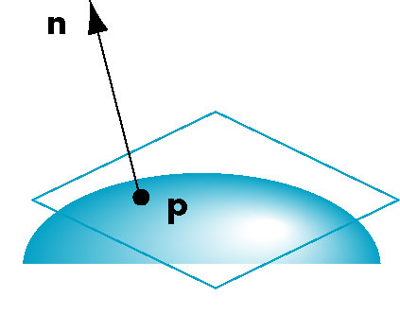
Normals
We can differentiate with respect to u and v to obtain the normal at any point p

Slide 14
Parametric Planes
n
point-vector form
r
p(u,v)=p₀+uq+vr
n = q x r
q
p₀
n
three-point form
p₂
q = p₁ – p₀
r = p₂ – p₀
p₁
p₀

Slide 15
Parametric Sphere
x(u,v) = r cos θ sin φ
y(u,v) = r sin θ sin φ
z(u,v) = r cos φ
360 ≥ θ ≥ 0
180 ≥ φ ≥ 0
constant: circles of constant longitude
φ constant: circles of constant latitude
differentiate to show n = p

Slide 16
Curve Segments
After normalizing u, each curve is written p(u)=[x(u), y(u), z(u)]^{T}, 1 ≥ u ≥ 0
In classical numerical methods, we design a single global curve
In computer graphics and CAD, it is better to design small connected curve segments
p(u)
join point p(1) = q(0)
q(1)
q(u)
p(0)

Slide 17
Parametric Polynomial Curves
If N=M=K, we need to determine 3(N+1) coefficients
Equivalently we need 3(N+1) independent conditions
Noting that the curves for x, y and z are independent,
we can define each independently in an identical manner
We will use the form
where p can be any of x, y, z

Slide 18
Why Polynomials
Easy to evaluate
Continuous and differentiable everywhere
Must worry about continuity at join points including continuity of derivatives
p(u)
q(u)
join point p(1) = q(0)
but p’(1) ≠ q’(0)

Slide 19
Cubic Parametric Polynomials
N=M=L=3, gives balance between ease of evaluation and flexibility in design
Four coefficients to determine for each of x, y and z
Seek four independent conditions for various values of u resulting in 4 equations in 4 unknowns for each of x, y and z
Conditions are a mixture of continuity requirements at the join points and conditions for fitting the data

Slide 20
Cubic Polynomial Surfaces
p(u,v)=[x(u,v), y(u,v), z(u,v)]^{T}
where
p is any of x, y or z
Need 48 coefficients (3 independent sets of 16) to
determine a surface patch

Slide 21
Interpolating Curve
p₁
p₃
p₀
p₂
Given four data (control) points p₀ , p₁ ,p₂ , p₃
determine cubic p(u) which passes through them
Must find c₀ ,c₁ ,c₂ , c₃

Slide 22
Interpolation Equations
apply the interpolating conditions at u=0, 1/3, 2/3, 1
p₀=p(0)=c₀
p₁=p(1/3)=c₀+(1/3)c₁+(1/3)²c₂+(1/3)³c₂
p₂=p(2/3)=c₀+(2/3)c₁+(2/3)²c₂+(2/3)³c₂
p₃=p(1)=c₀+c₁+c₂+c₂
or in matrix form with p = [p₀ p₁ p₂ p₃]^{T}
p=Ac

Slide 23
Interpolation Matrix
Solving for c we find the interpolation matrix
c=M_{I}p
Note that M_{I} does not depend on input data and
can be used for each segment in x, y, and z

Slide 24
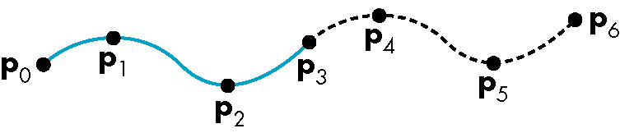
Interpolating Multiple Segments
use p = [p₃ p₄ p₅ p₆]^{T}
use p = [p₀ p₁ p₂ p₃]^{T}
Get continuity at join points but not
continuity of derivatives

Slide 25
Other Types of Curves and Surfaces
How can we get around the limitations of the interpolating form
Lack of smoothness
Discontinuous derivatives at join points
We have four conditions (for cubics) that we can apply to each segment
Use them other than for interpolation
Need only come close to the data

Slide 26
Hermite Form
p’(0)
p’(1)
p(0)
p(1)
Use two interpolating conditions and
two derivative conditions per segment
Ensures continuity and first derivative
continuity between segments

Slide 27
Equations
Interpolating conditions are the same at ends
p(0) = p₀ = c₀
p(1) = p₃ = c₀+c₁+c₂+c₃
Differentiating we find p’(u) = c₁+2uc₂+3u²c₃
Evaluating at end points
p’(0) = p’₀ = c₁
p’(1) = p’₃ = c₁+2c₂+3c₃

Slide 28
Matrix Form
Solving, we find c=M_{H}q where M_{H} is the Hermite matrix

Slide 29
Blending Polynomials
p(u) = b(u)^{T}q
Although these functions are smooth, the Hermite form
is not used directly in Computer Graphics and CAD
because we usually have control points but not derivatives
However, the Hermite form is the basis of the Bezier form

Slide 30
Parametric and Geometric Continuity
We can require the derivatives of x, y,and z to each be continuous at join points (parametric continuity)
Alternately, we can only require that the tangents of the resulting curve be continuous (geometry continuity)
The latter gives more flexibility as we have need satisfy only two conditions rather than three at each join point

Slide 31
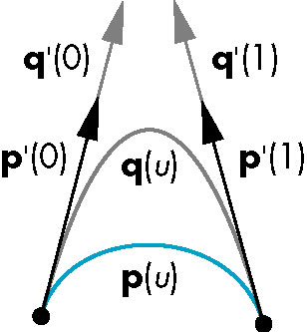
Example
Here the p and q have the same tangents at the ends of the segment but different derivatives
Generate different Hermite curves
This techniques is used in drawing applications

Slide 32
Pierre Bezier
French engineer (1910-1999)
Worked for Renault
Needed a way to describe free-form 3D surfaces for car bodies
Bezier curves and surfaces
Widely publicized
SIGGRAPH 1985 award for lifetime contribution

Slide 33
Bezier’s Idea
In graphics and CAD, we do not usually have derivative data
Bezier suggested using the same 4 data points as with the cubic interpolating curve to approximate the derivatives in the Hermite form

Slide 34
Approximating Derivatives
p₁
p₂
p₁ located at u=1/3
p₂ located at u=2/3
slope p’(0)
slope p’(1)
p₀
p₃
u

Slide 35
Equations
Interpolating conditions are the same
p(0) = p₀ = c₀
p(1) = p₃ = c₀+c₁+c₂+c₃
Approximating derivative conditions
p’(0) = 3(p₁- p₀) = c₀
p’(1) = 3(p₃- p₂) = c₁+2c₂+3c₃
Solve four linear equations for c=M_{B}p

Slide 36
Bezier Matrix
p(u) = u^{T}M_{B}p = b(u)^{T}p
blending functions

Slide 37
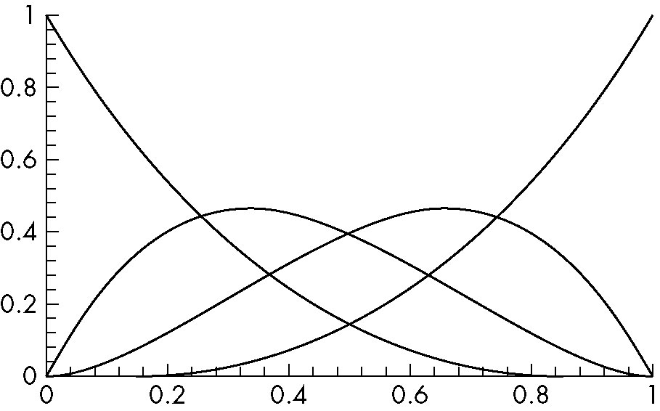
Blending Functions
Note that all zeros are at 0 and 1 which forces
the functions to be smooth over (0,1)

Slide 38
Bernstein Polynomials
The blending functions are a special case of the Bernstein polynomials
These polynomials give the blending polynomials for any degree Bezier form
All zeros at 0 and 1
For any degree they all sum to 1
They are all between 0 and 1 inside (0,1)

Slide 39
Convex Hull Property
The properties of the Bernstein polynomials ensure that all Bezier curves lie in the convex hull of their control points
Hence, even though we do not interpolate all the data, we cannot be too far away
p₁
p₂
convex hull
Bezier curve
p₀
p₃

Slide 40
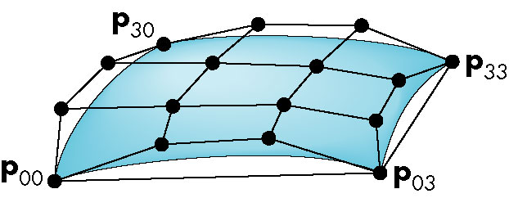
Bezier Patches
Using same data array P=[p_{ij}] as with interpolating form
Patch lies in
convex hull

Slide 41
Analysis
Although the Bezier form is much better than the interpolating form, the derivatives are not continuous at join points
Can we do better?
Go to higher order Bezier
More work
Derivative continuity still only approximate
Supported by OpenGL
Apply different conditions
Tricky without letting order increase

Slide 42
B-Splines
Basis splines: use the data at p=[p_{i-2} p_{i-1} p_{i} p_{i-1}]^{T} to define curve only between p_{i-1} and p_{i}
Allows us to apply more continuity conditions to each segment
For cubics, we can have continuity of function, first and second derivatives at join points
Cost is 3 times as much work for curves
Add one new point each time rather than three
For surfaces, we do 9 times as much work

Slide 43
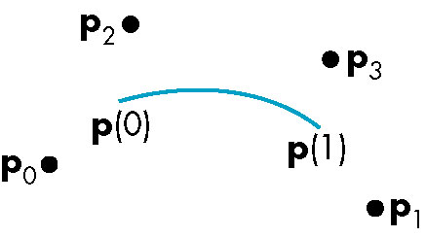
Cubic B-spline
p(u) = u^{T}M_{S}p = b(u)^{T}p

Slide 44
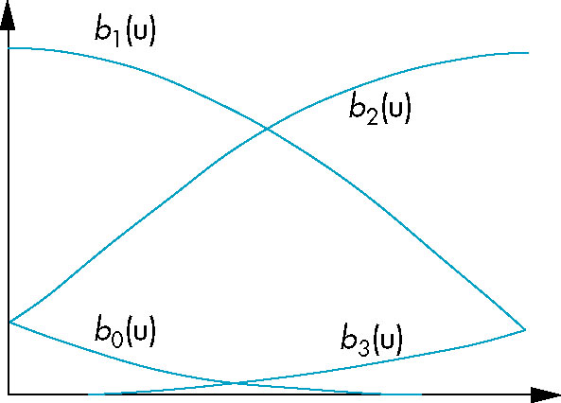
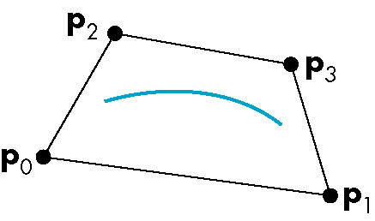
Blending Functions
convex hull property

Slide 45
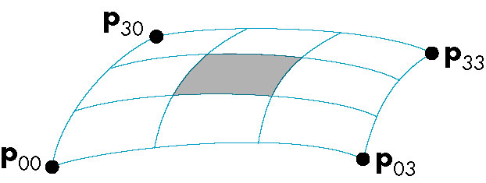
B-Spline Patches
defined over only 1/9 of region

Slide 46
Splines and Basis
If we examine the cubic B-spline from the perspective of each control (data) point, each interior point contributes (through the blending functions) to four segments
We can rewrite p(u) in terms of the data points as
defining the basis functions {B_{i}(u)}

Slide 47
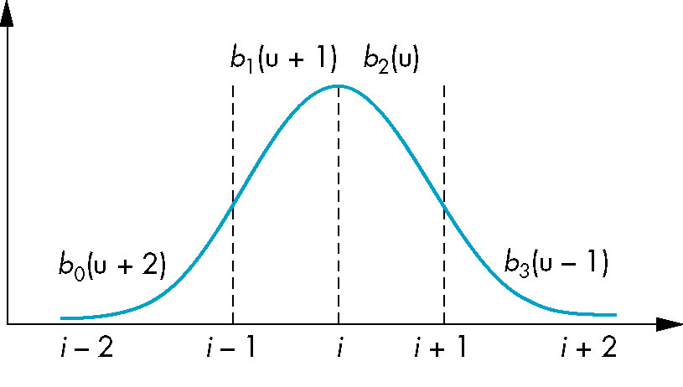
Basis Functions
In terms of the blending polynomials

Slide 48
Generalizing Splines
We can extend to splines of any degree
Data and conditions to not have to given at equally spaced values (the knots)
Nonuniform and uniform splines
Can have repeated knots
Can force spline to interpolate points
Cox-deBoor recursion gives method of evaluation

Slide 49
NURBS
Nonuniform Rational B-Spline curves and surfaces add a fourth variable w to x,y,z
Can interpret as weight to give more importance to some control data
Can also interpret as moving to homogeneous coordinate
Requires a perspective division
NURBS act correctly for perspective viewing
Quadrics are a special case of NURBS

Slide 50
What Does OpenGL Support?
Evaluators: a general mechanism for working with the Bernstein polynomials
Can use any degree polynomials
Can use in 1-4 dimensions
Automatic generation of normals and texture coordinates
NURBS supported in GLU
Quadrics
GLU and GLUT contain polynomial approximations of quadrics

Slide 51
One-Dimensional Evaluators
Evaluate a Bernstein polynomial of any degree at a set of specified values
Can evaluate a variety of variables
Points along a 2, 3 or 4 dimensional curve
Colors
Normals
Texture Coordinates
We can set up multiple evaluators that are all evaluated for the same value

Slide 52
Setting Up an Evaluator
what we want to evaluate
max and min of u
glMap1f(type,u_min,u_max,stride,
order, pointer_to_array)
separation between
data points
1+degree of polynomial
pointer to control data
Each type must be enabled by glEnable(type)

Slide 53
Example
Consider an evaluator for a cubic Bezier curve over (0,1)
point data[ ]={…………..}; * /3d data /*
glMap1f(GL_MAP_VERTEX_3,0.0,1.0,3,4,data);
data are 3D vertices
cubic
data are arranged as x,y,z,x,y,z……
three floats between data points in array
glEnable(GL_MAP_VERTEX_3);

Slide 54
Evaluating
The function glEvalCoord1f(u) causes all enabled evaluators to be evaluated for the specified u
Can replace glVertex, glNormal, glTexCoord
The values of u need not be equally spaced

Slide 55
Example
Consider the previous evaluator that was set up
for a cubic Bezier over (0,1)
Suppose that we want to approximate the curve
with a 100 point polyline
glBegin(GL_LINE_STRIP)
for(i=0; i<100; i++)
glEvalCoord1f( (float) i/100.0);
glEnd();

Slide 56
Equally Spaced Points
Rather than use a loop, we can set up an equally spaced mesh (grid) and then evaluate it with one function call
glMapGrid(100, 0.0, 1.0);
sets up 100 equally-spaced points on (0,1)
glEvalMesh1(GL_LINE, 0, 99);
renders lines between adjacent evaluated
points from point 0 to point 99

Slide 57
Bezier Surfaces
Similar procedure to 1D but use 2D evaluators in u and v
Set up with
glMap2f(type, u_min, umax, u_stride, u_order, v_min, v_max, v_stride, v_order, pointer_to_data)
Evaluate with glEvalCoord2f(u,v)

Slide 58
Example
bicubic over (0,1) x (0,1)
point data[4][4]={………};
glMap2f(GL_MAP_VERTEX_3, 0.0, 1.0, 3, 4,
0.0, 1.0, 12, 4, data);
Note that in v direction data points
are separated by 12 floats since array
data is stored by rows

Slide 59
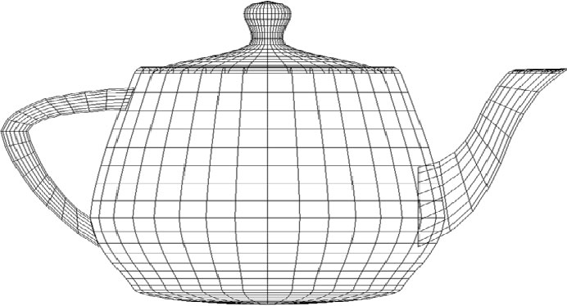
Rendering with Lines
must draw in both directions
for(j=0;j<100;j++) {
glBegin(GL_LINE_STRIP);
for(i=0;i<100;i++)
glEvalCoord2f((float) i/100.0, (float) j/100.0);
glEnd();
glBegin(GL_LINE_STRIP);
for(i=0;i<100;i++)
glEvalCoord2f((float) j/100.0, (float) i/100.0);
glEnd();
}

Slide 60
Rendering with Quadrilaterals
We can form a quad mesh and render with lines
for(j=0; j<99; j++) {
glBegin(GL_QUAD_STRIP);
for(i=0; i<100; i++) {
glEvalCoord2f ((float) i/100.0,
(float) j/100.0);
glEvalCoord2f ((float)(i+1)/100.0,
(float)j/100.0);
}
glEnd():
}

Slide 61
Uniform Meshes
We can form a 2D mesh (grid) in a similar manner to 1D for uniform spacing
glMapGrid2(u_num, u_min, u_max, v_num, v_min, v_max)
Can evaluate as before with lines or if want filled polygons
glEvalMesh2( GL_FILL, u_start, u_num, v_start, v_num)

Slide 62
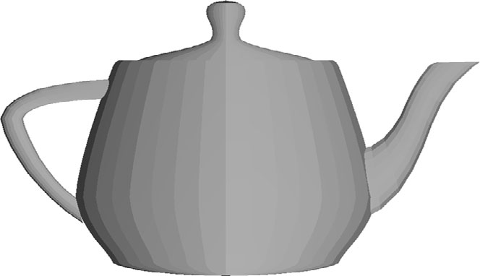
Rendering with Lighting
If we use filled polygons, we have to shade or we will see solid color uniform rendering
Can specify lights and materials but we need normals
Let OpenGL find them
glEnable(GL_AUTO_NORMAL);

Slide 63
NURBS
OpenGL supports NURBS surfaces through the GLU library
Why GLU?
Can use evaluators in 4D with standard OpenGL library
However, there are many complexities with NURBS that need a lot of code
There are five NURBS surface functions plus functions for trimming curves that can remove pieces of a NURBS surface

Slide 64
Quadrics
Quadrics are in both the GLU and GLUT libraries
Both use polygonal approximations where the application specifies the resolution
Sphere: lines of longitude and lattitude
GLU: disks, cylinders, spheres
Can apply transformations to scale, orient, and position
GLUT: Platonic solids, torus, Utah teapot, cone

Slide 65
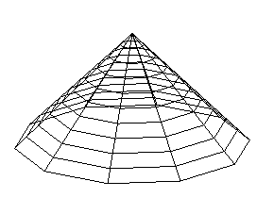
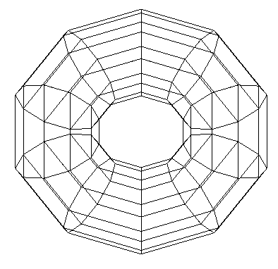
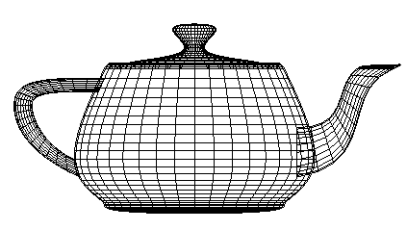
GLUT Objects
Each has a wire and a solid form
glutWireCone()
glutWireTorus()
glutWireTeapot()

Slide 66
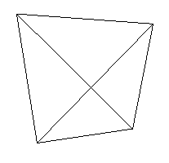
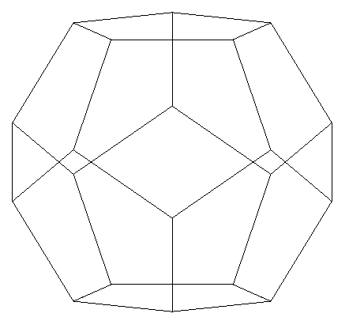
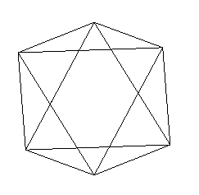
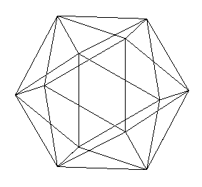
GLUT Platonic Solids
glutWireTetrahedron()
glutWireDodecahedron()
glutWireOctahedron()
glutWireIcosahedron()

Slide 67
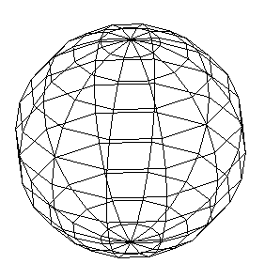
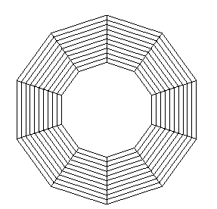
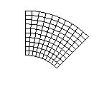
Quadric Objects in GLU
GLU can automatically generate normals and texture coordinates
Quadrics are objects that include properties such as how we would like the object to be rendered
partial disk
disk
sphere

Slide 68
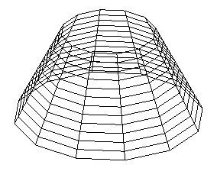
Defining a Cylinder
GLUquadricOBJ *p;
P = gluNewQuadric(); /*set up object */
gluQuadricDrawStyle(GLU_LINE);/*render style*/
gluCylinder(p, BASE_RADIUS, TOP_RADIUS,
BASE_HEIGHT, sections, slices);

